Slide 1
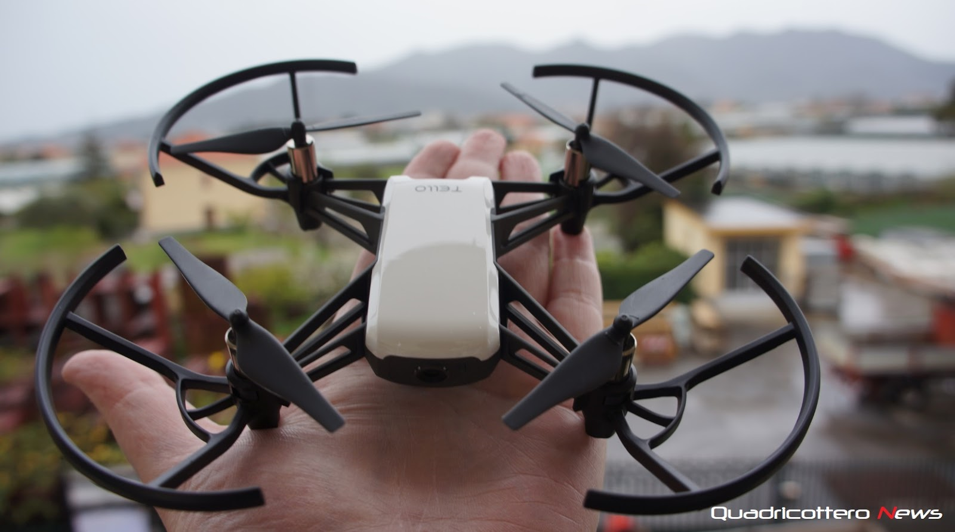
OBJECT DETECTION and AVOIDANCE on DJI TELLO DRONE
Guruvaraprasad Borra

Slide 2
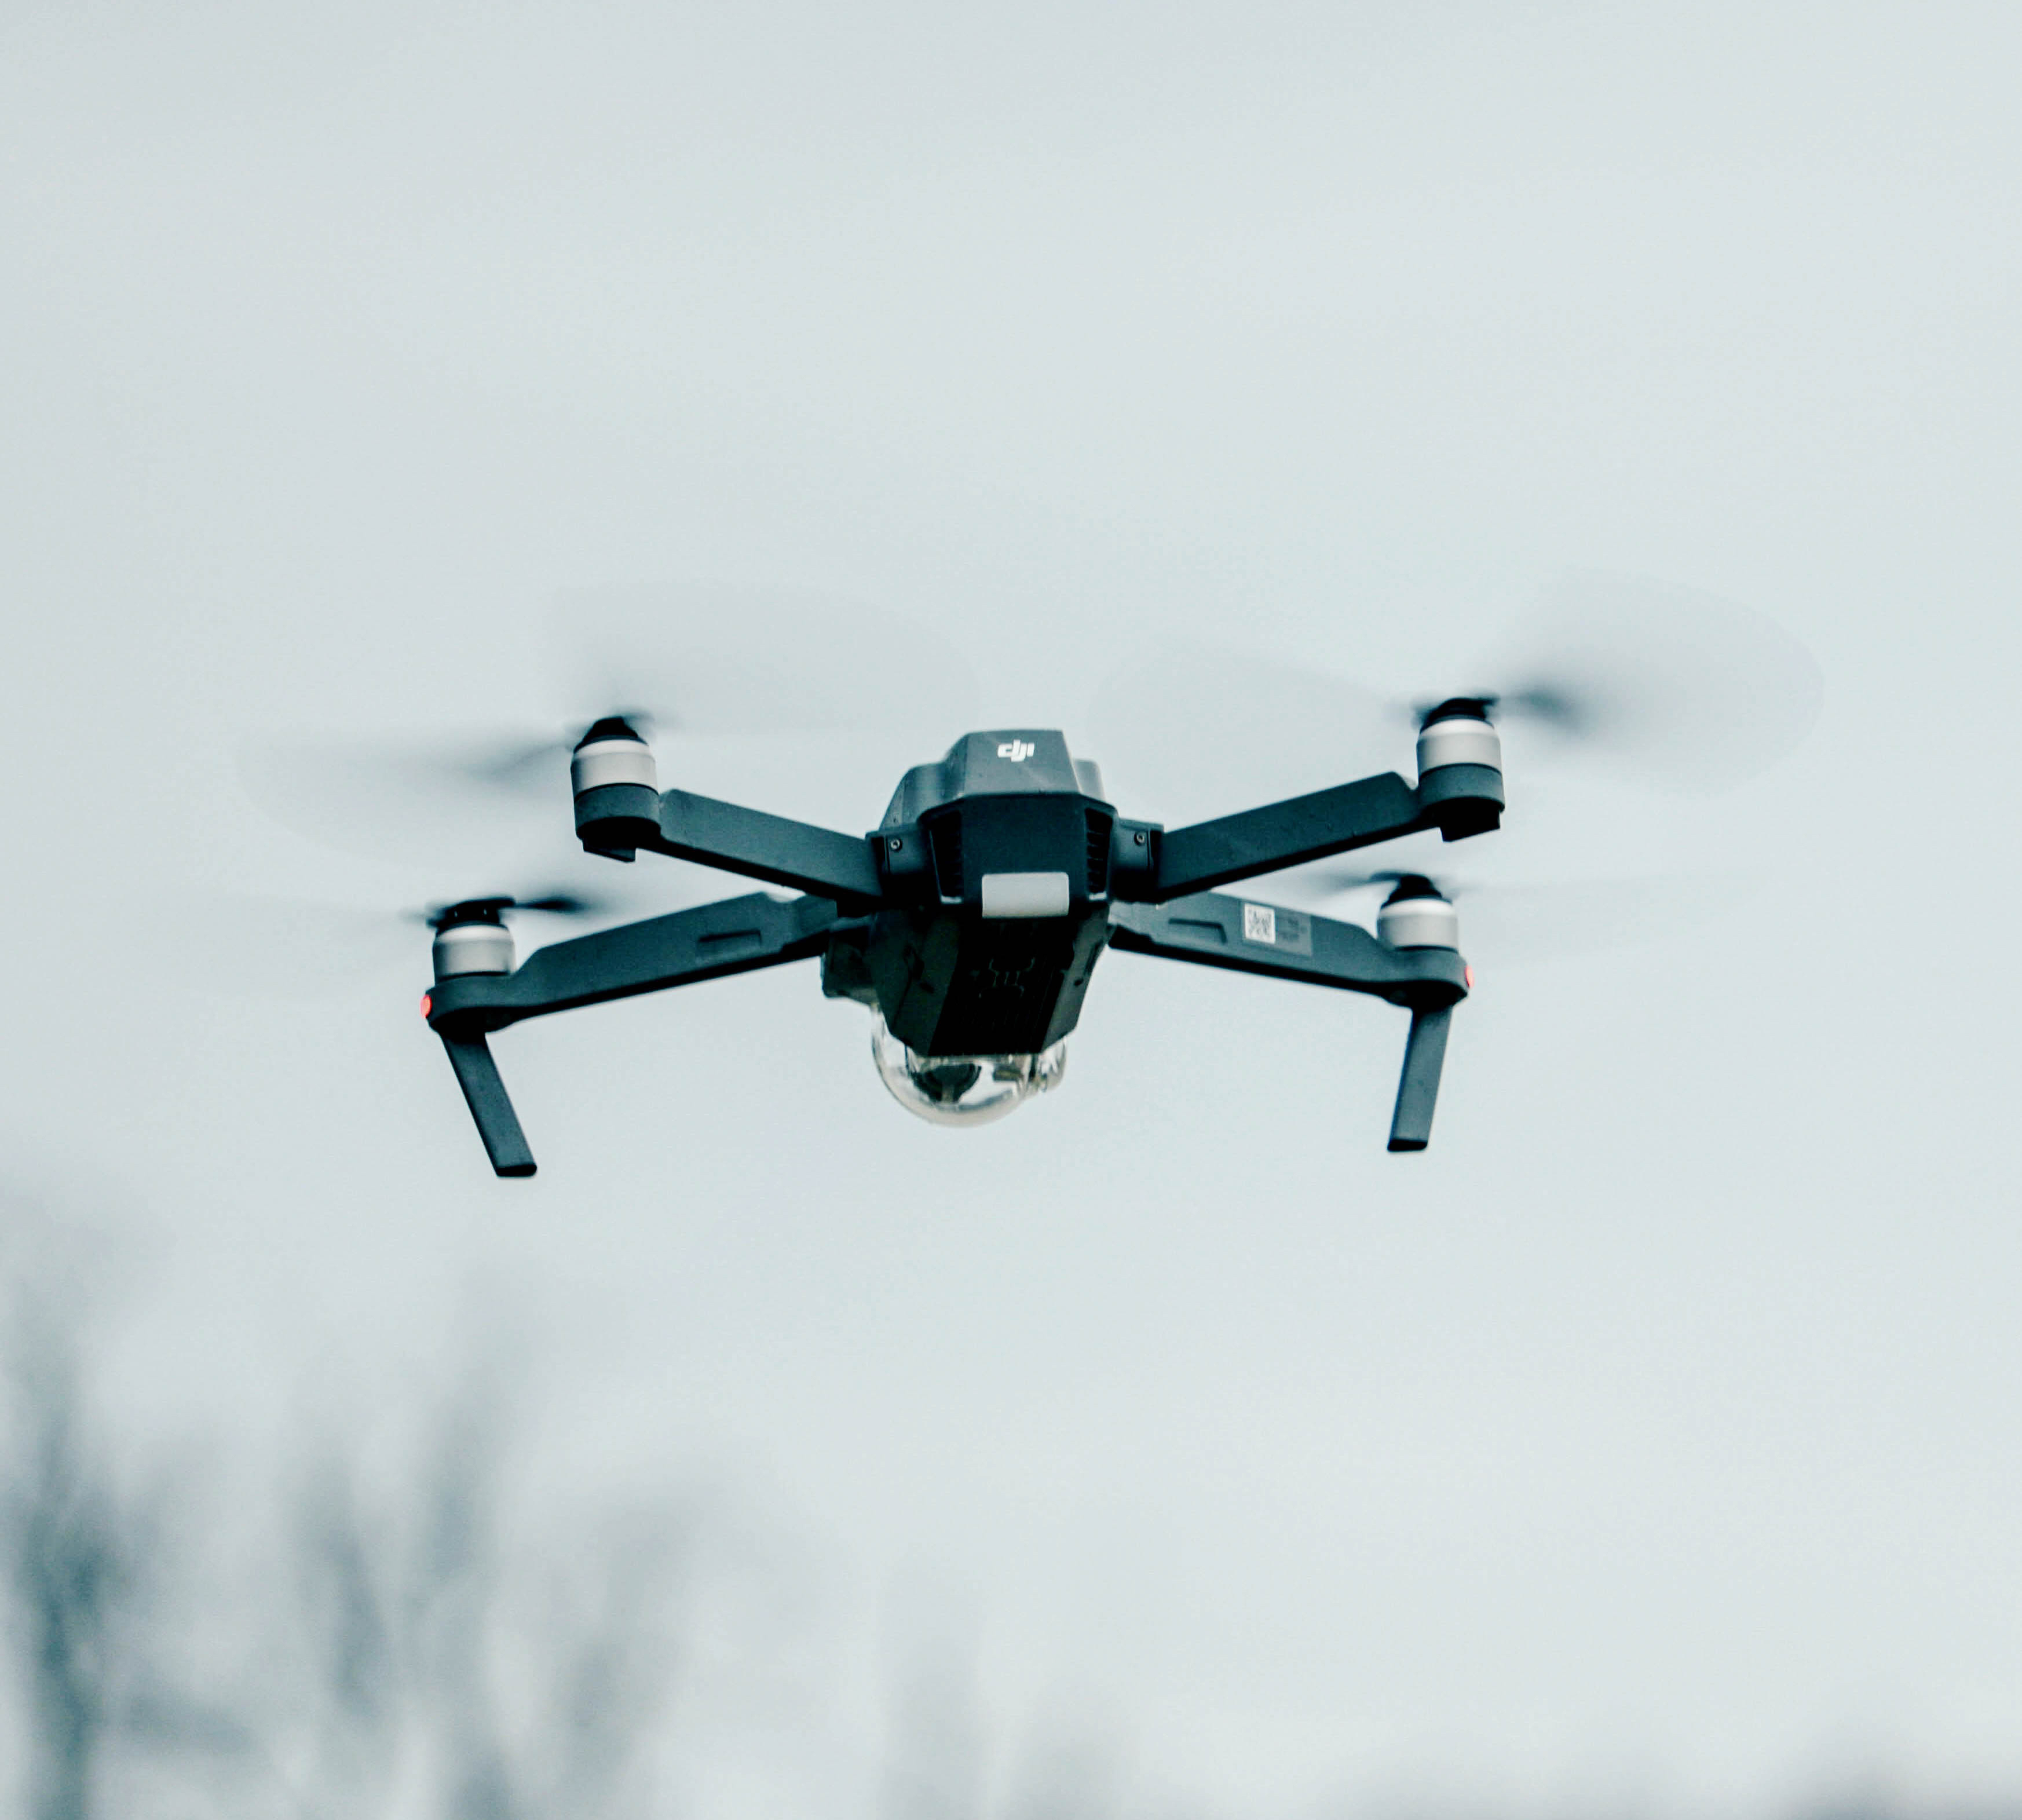
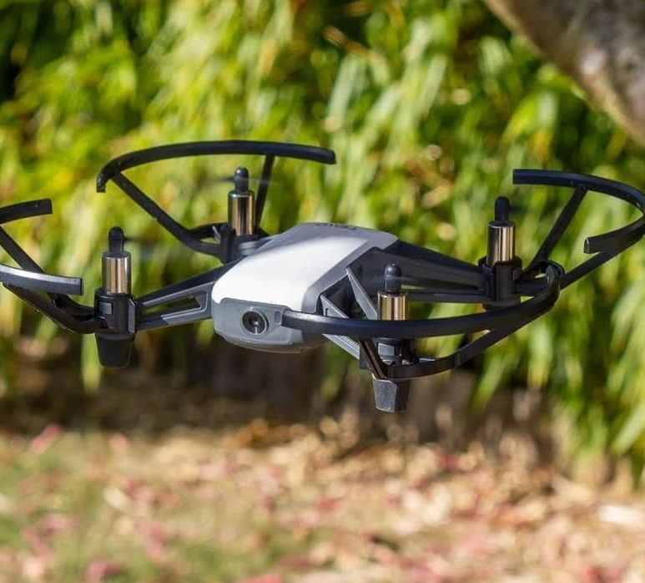
Contents
Introduction
Objective
Project Workflow
Overview of YOLO,DeepOCSORT
Results
Applications
Challenges

Slide 3
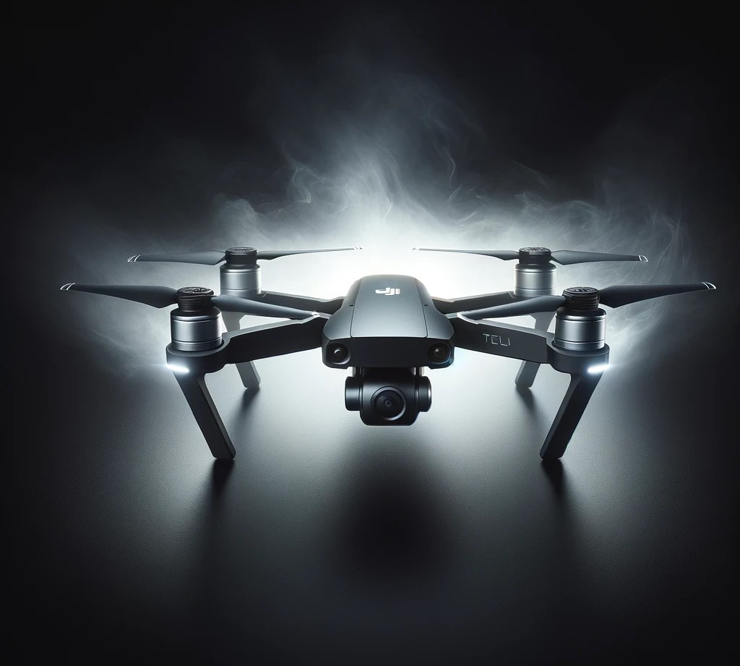
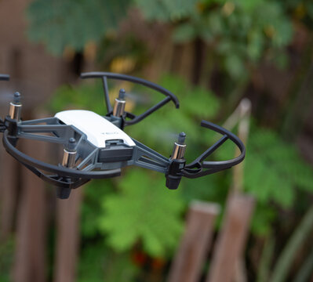
INTRODUCTION
This project focuses on integrating YOLO and DeepOCSORT algorithms into a DJI Tello drone for real-time object detection and tracking.
Object detection and tracking enable autonomous decision-making, enhancing safety and efficiency in robotics.

Slide 4
Objective
Object Detection
Object Tracking
Analyze Speed and Time to Collision
Collision Avoidance

Slide 5
Project Workflow
Drone Initialization
Setting up DJI Tello for seamless operation and connectivity.
Capturing Frames
Acquiring real-time video frames for object detection.
Object Detection
Identifying objects using YOLO's deep learning model.
Continuously tracking objects with unique ID's in frames
Object Tracking
Calculating paths to prevent collisions with detected obstacles.
Making sure that the drone is calibrated and prepared for flying steadily and precisely.
Gathering continuous frames from the drone's camera for processing.
Using size, kind, or confidence level to filter discovered items.
Examining patterns of object movement to forecast future directions
Use real-time data to prioritize the safest and most effective routes.
Avoidance System
Object Detection and avoidance on DJI Tello drone
5

Slide 6
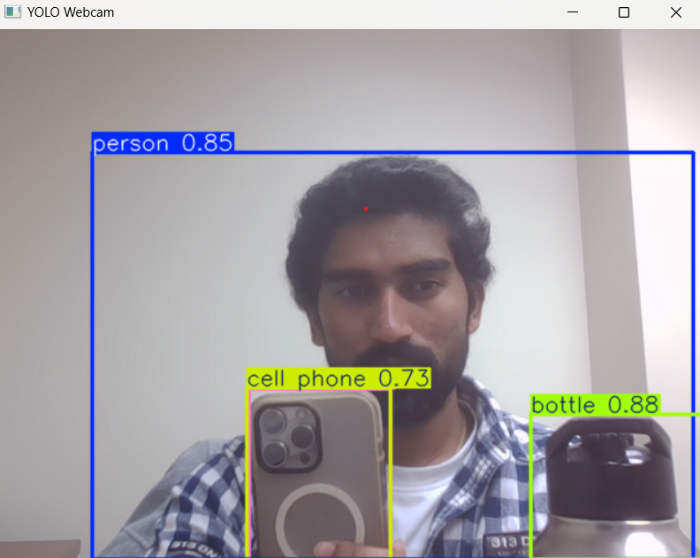
Overview of YOLO
You Only Look Once (YOLO) is a real-time object detection algorithm that detects objects in a single forward pass of a neural network.
Key Features
Efficiency and speed for programs that run in real time.
High precision while using less processing power.
Using object categorization to make bounding box predictions.
YOLO was chosen for this project because it is optimized for lightweight devices like the DJI Tello, ensuring fast and accurate detection

Slide 7
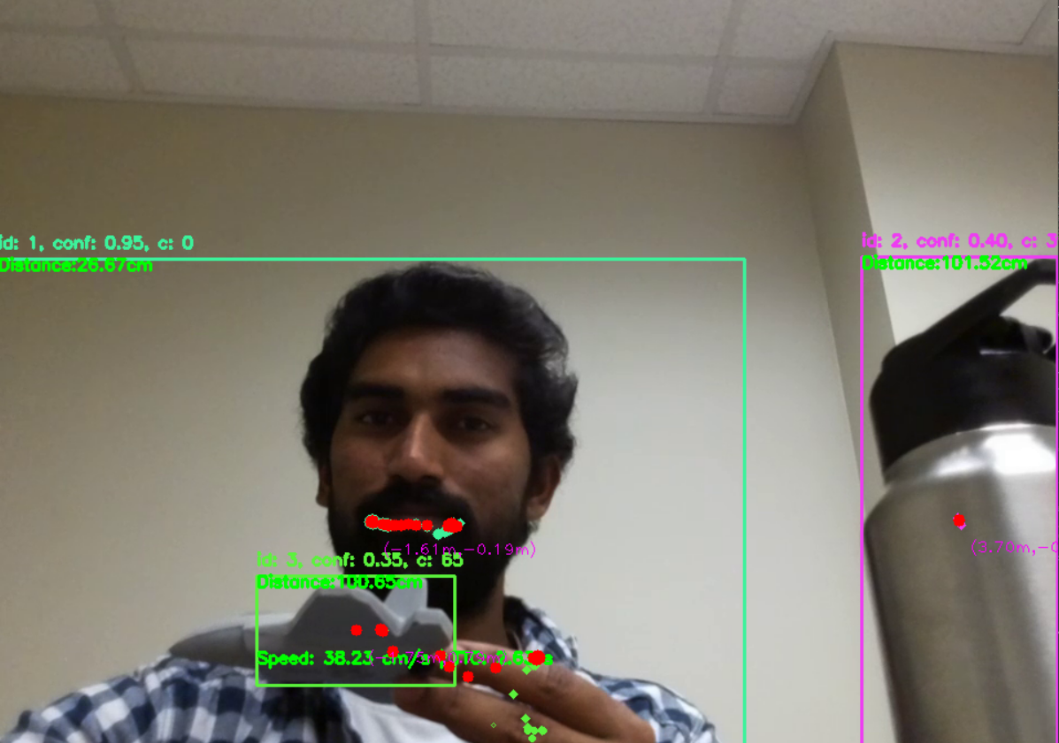
Overview of Deepocsort
DeepOCSORT is an improved version of the SORT (Simple Online and Realtime Tracking) algorithm that incorporates deep feature embedding to overcome the drawbacks of traditional tracking techniques.
Key Features
Multi-Object Tracking
Deep Learning for Re-Identification
Handling Complex Scenarios
Ensures robust tracking of obstacles, people or vehicles for safe autonomous flight.
Maintains consistent tracking in crowded or complex environments example: Tracks players and objects like ball across frames to analyze motion patterns in sports.

Slide 8
Hardware
DJI TELLO DRONE
LAPTOP
Compact, lightweight, and Easy operation
Equipped with a 720p camera for object detection and tracking.
5MP Photos, Multiple Flight Modes, 13 Min Flight time
Coding and Drone technology experimentations
Educational tools in schools and workshops
Recreational photography and videography.
Laptop :Lenovo IdeaPad slim5
Processor : 11th Gen Intel Core i5
RAM : 16 GB
System : 64-bit operating system
Windows : Windows 11

Slide 9
Software and tools
Language
Libraries
Development Tools
Python – Chosen for its versatility and rich library ecosystem
CV2
Numpy
Sys
Argparse
Os
Math
Time
Utralytics
Boxmot
Datatime
Keyboard
Pathlib
djitellopy
Anaconda
Visual Code

Slide 10
Data logging and experiment setup
Data Logging
Experiment Setup
Keeps track of an object's distance, speed, and location for trajectory analysis.
Keeps track of timestamps for measuring performance and processing time measurements.
Permits post-experiment assessments and troubleshooting.
Controlled testing in an indoor environment with pre-established barriers.
A laptop transmits orders after processing a live drone camera feed.
Based on detection and tracking data, the drone was calibrated to navigate.

Slide 11
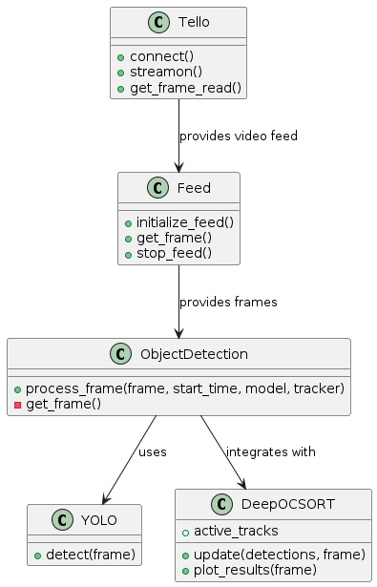
Real-Time Object Detection
YOLO efficiently detects multiple objects in real-time using a single-pass CNN-based approach, ideal for dynamic applications like drones.
Frame capture → YOLO inference → Bounding box generation with confidence scores and class labels.
Performance Metrics:
Speed: High FPS (45-60+) ensures smooth operation.
Accuracy: mAP over 90% in ideal conditions.
Example video frames with bounding boxes and labels, showcasing real-time detection in diverse scenarios.

Slide 12
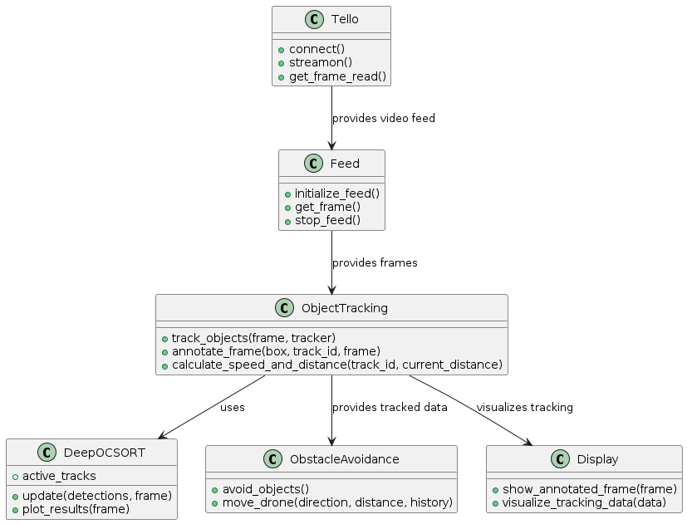
Object Tracking with DeepOCSORT
Maintain object continuity across frames for dynamic navigation.
Detection → Data association → ID assignment → Re-identification for lost objects.
Key Features:
Occlusion handling and re-identification ensure robust tracking.
Stable tracking in cluttered, fast-paced environments.
Object IDs across frames and trajectories showing consistent tracking in dynamic environments.

Slide 13
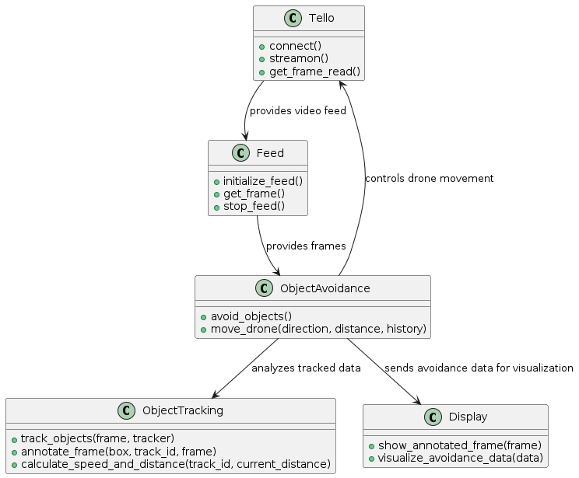
Avoidance Mechanism
Core Idea: Enable drones to navigate safely by predicting object movements and planning collision-free paths.
Decision-Making Process:
Integration: Combines detection and tracking data for real-time obstacle avoidance.
Performance Metrics:
Reaction Time: Detection-to-maneuver time.
Accuracy: Predicting object movements and adjusting paths

Slide 14
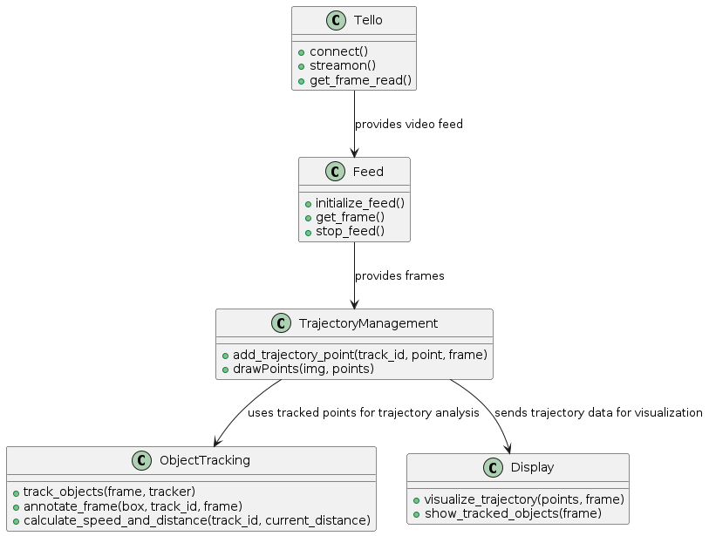
Trajectory Analysis
Understand object movement patterns to predict future positions for safe navigation.
Extract and analyze object trajectories over time.
Distance traveled, velocity estimation, and prediction accuracy.
Plan paths based on predicted trajectories.

Slide 15
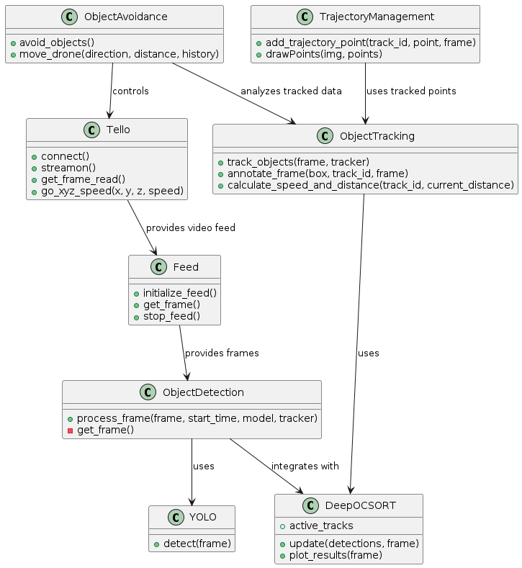
Flow chart of the project

Slide 16
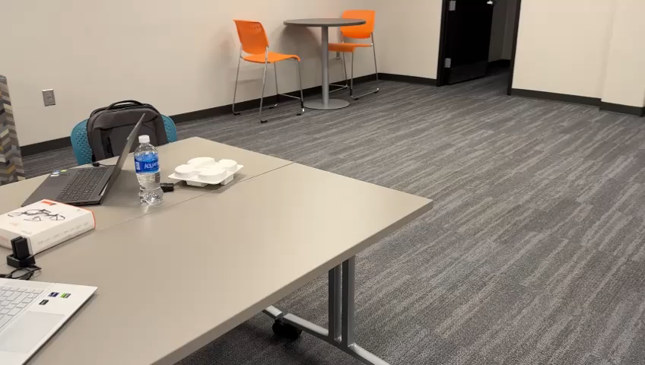
Results
Video captured from my phone

Slide 17
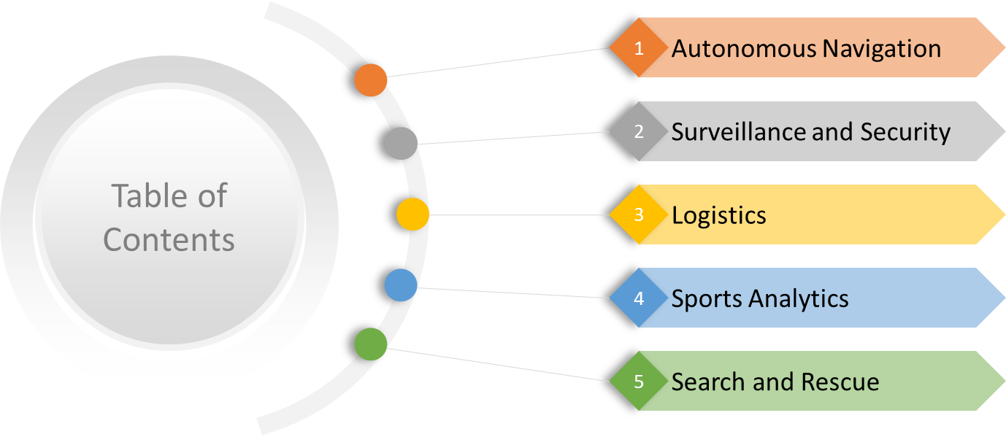
Applications

Slide 18

Challenges faced
Hardware Limitations
Algorithmic Issues
Delay in feed
Integration Difficulties
Drone calibrations

Slide 19

Improvements and Optimizations
Algorithm Tuning
Hardware Upgrades
Environmental Adaptations
Tracking Enhancements Path Planning Organizations

Slide 20
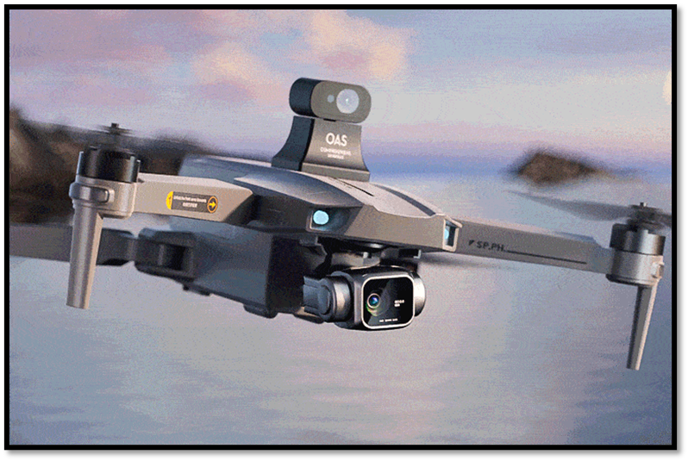


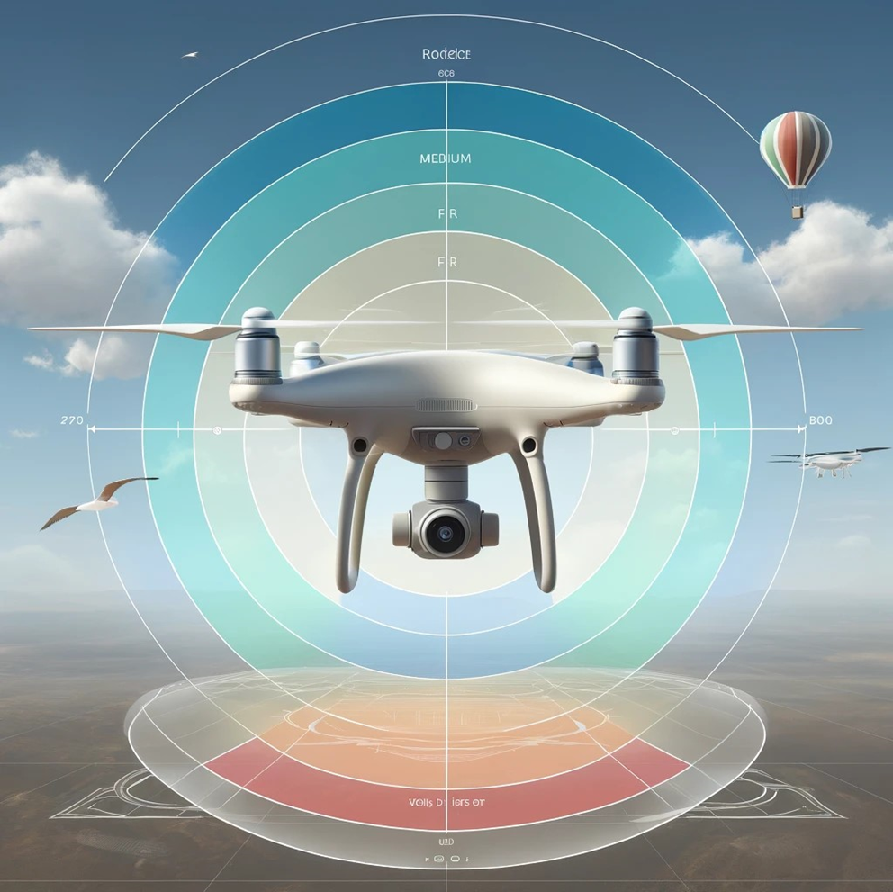
Conclusion
Using the DeepOCSORT and YOLO algorithms for precise trajectory analysis, this research effectively deployed real-time object identification and tracking on the DJI Tello drone.
The findings highlight the integration of cutting-edge AI-driven robotics capabilities and show promise for improving drone autonomy.
This study highlights the revolutionary potential of incorporating state-of-the-art object identification and tracking technology into robotics, laying the foundation for safer, smarter autonomous systems.
12/05/2024

Slide 21

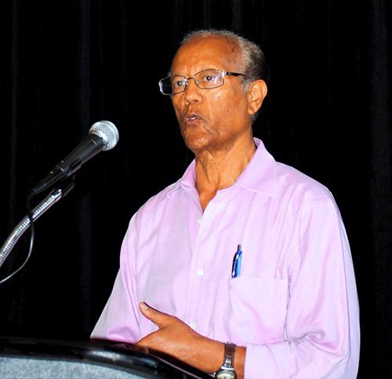
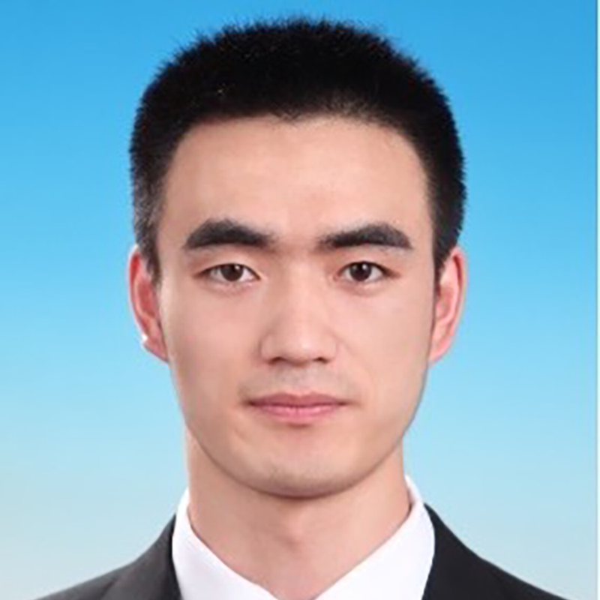
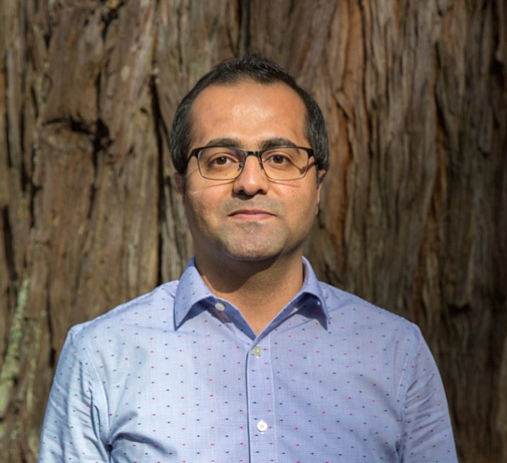
acknowledgeMENT
12/05/2024
Dr. Mahmut Reyhanoglu
Dr. Abiye Seifu
Dr. Qi Zou
Dr. Mohammad Jafari
Program Director
Professor
Assistant Professor
Advisor
21

Slide 22

THANK YOU
Guruvaraprasad Borra
Robotic Engineering
Columbus State University

